Slide 1
A graph extension of the positional
Burrows–Wheeler transform and its applications
NAME | ROLL NUMBER
GUTTULA SAI NAGA TEJA | AM.EN.U4AIE20034
LOKAVARAPU VARSHA | AM.EN.U4AIE20044
MUCHARLA DEEKSHA | AM.EN.U4AIE20050
S KRISHNA SANDEEP REDDY | AM.EN.U4AIE20061

Slide 2
PROJECT SUMMARY
We recommend the graph PBWT, an interpretation of the “Positional Burrows–Wheeler transform (PBWT)” to genomic graphs.
The graph PBWT is a compressed interpretation of a collection of these graph-encrypted haplotypes that enables sub-haplotype match examinations.
For graph PBWT creation and query functions, we provide effective algorithms.
We utilise the graph PBWT to analyse the quantity of haplotypes consistent with arbitrary moves in a genome graph and the pathways travelled by mapped reads as an example.
We approximate that a single large compute node might store and search for haplotype queries on the order of 100,000 diploid genomes, as well as all kinds of fundamental variation, using the graph PBWT.

Slide 3
BACKGROUND STUDY
The Positional Burrows–Wheeler transform is a compact data model for preserving haplotypes that allows for fast sub haplotype match searches.
The PBWT is an expansion of the standard Burrows–Wheeler transform, a technique for reducing string data that borrows some notions from the FM-index, a navigable version of the BWT.
Current haplotype-based techniques can also use the PBWT to operate on far bigger datasets of haplotypes than should have been possible.
The haplotype address syndicate dataset, for instance, has 50,000 haplotypes, and PBWT-based equipment allows data at this level to easily guide phasing predictions on newly sequenced specimens with considerable speedups above other methodologies.

Slide 4
BACKGROUND STUDY
Every point (which corresponds to a gene mutation) is a binary component in the PBWT, and the points are completely sorted.
The PBWT accepts binary strings as source haplotypes, among each component denoting the status of a point.Because graph-based techniques to genomics challenges like mapping and variant recognition have indeed been demonstrated to outperform linear-reference-based methodologies.
There were other adaptations of BWT-based methods to the graph framework, but they mostly focus with the substring problem instead of the challenge of preserving and retrieving haplotypes.

Slide 5
LITERATURE SURVEY
We regard the modern past of a thread to be a reliable predictor of where the thread is likely to move ahead, just as we do with the positional Burrows–Wheeler transformation, that is used to record haplotypes it against linear baseline, and the conventional Burrows–Wheeler transform.
We may utilise optimal compression algorithms (including such run-length compression algorithms) and gain remarkable reduction by clustering together the next side data so that close elements are capable of exchanging data.

Slide 6
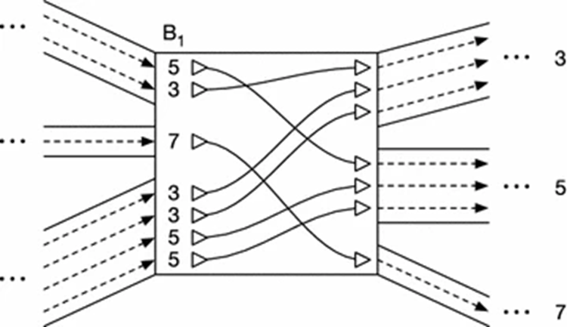
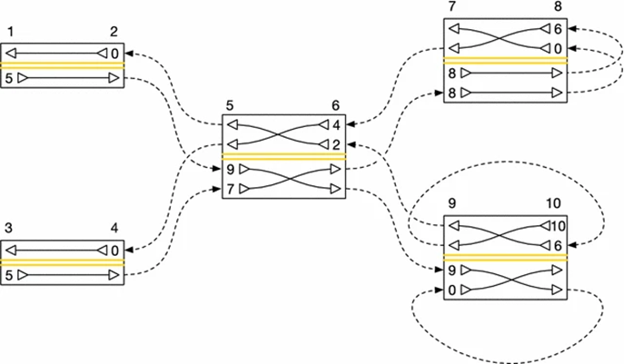
The Graph Positional Burrows–Wheeler Transform

Slide 7
METHODS AND ALGORITHMS
ALGORITHM 2
Algorithm for embedding a thread in a graph.
ALGORITHM 1
ALGORITHM 3
Algorithm for extracting threads from a graph
Algorithm for searching for a sub thread in the graph.

Slide 8
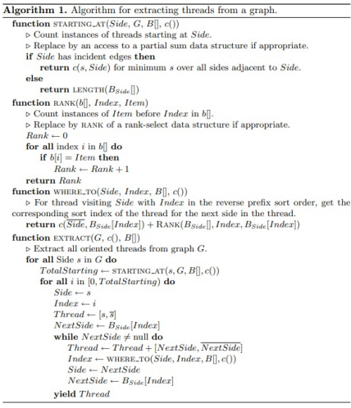
ALGORITHM 1
Take each side s in G in turn to recreate T and the gPBWT. And we must create threads that begin at s that takes the minimum of c (x, s) to all the sides x which will be adjacent to s
When s consists of no edges, we take the length of Bs [], and we name this number b.
For the new thread to begin, the i must exclusively run from 0 to b which will have the side S.
And if it is on the null side of the thread, we must avoid traversing and obtain the thread and start from the original node s again with i in which the next value will be less then b.
If at all it’s not on the null side, we traverse to a new side s’ and then calculate the sum of initial or arrival index of i’ (new value of i) and number of entries in Bs [].
Hence, it obtains the index in s’ when the thread is being extracted.

Slide 9
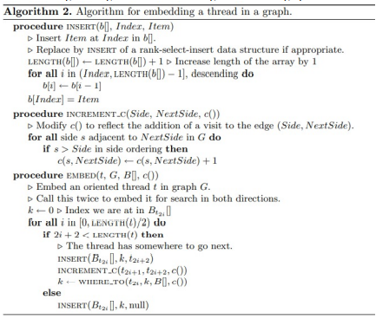
ALGORITHM 2
Here is an efficient algorithm for gPBWT construction where the process of construction of gPBWT is reduced into the embedding of an thread.
Every thread is embedded by two orientations in which it follows a proper order. In order to embed a thread t we must primarily look at the node n entering the thread.
We then for every new entry fit in a Bto [] which lengthens the array.
The new item is near the beginning, before all the entries for visits coming by edges, with the precise location defined by the thread orientations’ arbitrary order.
Therefore, if no alternate order of thread orientations emerges, the order established by their addition to the graph will serve, in which case the new item can be added to Bt0 [].

Slide 10
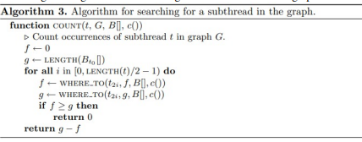
ALGORITHM 3
Some of the original PBWT’s efficient haplotype search features are preserved in the generalised PBWT data structure provided here.
We start by naming fi and gi as the first and the before last of the positions for the range of different threads.
The very first step is to initialize f0 to 0 and go to length of Bt0 after initializing they all visit the node through t0.
From the next steps we calculate f(i+1) and g(i+1) from fi and gi respectively by using the “WHERE_TO()” function.
The process must take place until which we can come to conclusion whether the threads in the graph have no matches to t.

Slide 11
RESULTS AND DISCUSSION
This process will enumerate all threads in the graph, and will enumerate each such thread twice (once from each end). The threads merely need to be reduplicated (such that two enumerated threads produce one actual thread, as the original collection of embedded threads may have had duplicates) in order to produce the collection of embedded threads T. Pseudocode for thread extraction is shown in Algorithm 1.
Setting k to this value, we can then repeat the preceding steps to embed t2, t3, etc. until t is exhausted and its embedding terminated with a null-side entry. Pseudo-code for this process is shown in Algorithm 2
Assuming that the B[] arrays have been indexed for O(1) rank queries, the algorithm is O(N) in the length of the subthread t to be searched for, and has a run time independent of the number of occurrences of t. Pseudocode is shown in Algorithm 3.

Slide 12
CONCLUSIONS
The core idea behind PBWT is to sort haplotypes in reversed prefix order.
It’s worth noting that the original BWT was created by Burrows and Wheeler (1994) for string data compression rather than search, and it’s the basis for the bzip compression technique.
As a result of this sorting, it is possible to find haplotype matches quickly.
Durbin (2014) uses Algorithm 1 to create a ”positional prefix array,” which is simply a list of haplotype indices that would arrange the haplotypes in inverted prefix order at position k.
We also looked at how to insert and delete particular haplotypes using efficient techniques.
A genome graph is a compressed illustration of a graphed collection of genomes. A haplotype relates to a limited kind of walk in a genomic network.

Slide 13
LIST OF REFERENCES
[1] Adam M. Novak, Erik Garrison Benedict Paten, “A graph extension of the positional Burrows–Wheeler transform and its applications”, July 2017.
[2] Guillaume Filion, Cesar H. Comin, A tutorial on Burrows-Wheeler indexing methods, July 2016.
[3] Khalid Sayood, “Data Compression”, Encyclopedia of Information Systems 2003.
[4] Phillip Compeau and Pavel Pevzner, “Bioinformatics algorithm, An active learning Approach”, Vol.1. and Vol. 2 , 2015.
[5] JinXiong, “Essential Bioinformatics”, Cambridge University Press, 2006.

Slide 14
THANK YOU
https://github.com/DeekshaMucharla/BIO_GPBWT_PROJECT

